Slide 1











EU SECURE EMAIL COMMUNICATION NETWORK ENHANCEMENT
under the guidance of Dr.Animesh Chaturvedi

Slide 2
team members
Challapalle Venkata Sainath Reddy -20BCS035
Bandarapu Deepak -20BCS027
Bhukya Jagadish Chandra - 20BCS032

Slide 3
TABLE OF CONTENT
Introduction
Dataset
Algorithms
Connected Components
Topological Insights
Temporal Insights
Conclusion

Slide 4
INTRODUCTION
The "EU Secure Email Communication Network Enhancement Project" aims to improve and strengthen secure email communication within the European Union (EU)
This project focuses on enhancing the security, efficiency, and reliability of email communication for EU institutions, member states, and associated organizations.

Slide 5
INTRODUCTION
By implementing advanced encryption techniques, robust authentication methods, and streamlined communication protocols, the project seeks to safeguard sensitive information, protect against cyber threats, and ensure the confidentiality and integrity of email exchanges
Through this initiative, the EU aims to bolster its email communication infrastructure, fostering trust and security among its various stakeholders.

Slide 6
DATASET
The Email-EuAll.txt dataset is a directed graph capturing email communication within a European research institution
The dataset covers the time period from October 2003 to March 2005.
It comprises a substantial scale, with 265,214 nodes and 420,045 edges.

Slide 7
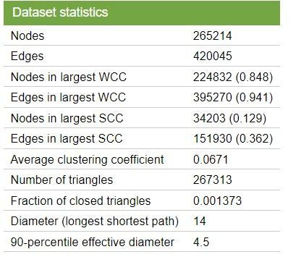
DATASET
This dataset provides valuable insights into the email communication dynamics within the research institution during the specified 18-month period
making it a valuable resource for network analysis, communication pattern studies, and potentially identifying active or important nodes within the institution's communication network

Slide 8
GRAPH ALGORITHMS
GraphX includes a set of graph algorithms to simplify analytics tasks. The algorithms are contained in the org.apache.spark.graphx.lib package and can be accessed directly as methods on Graph via GraphOps.
Connected Component

Slide 9
CONNECTED COMPONENTS
The connected components algorithm labels each connected component of the graph with the ID of its lowest-numbered vertex
This means that each cluster of connected nodes is assigned a unique identifier based on the ID of the node with the lowest number within that cluster

Slide 10
CONNECTED COMPONENTS
This can be especially useful in various applications, including community detection in social networks.
To perform the connected components algorithm, you can use GraphX, a graph processing library often used with Apache Spark

Slide 11
TOPOLOGICAL INSIGHTS
By analyzing the connected components, the project aims to understand the topological structure of the email network. This can provide information about the organization of the institution's email communication.

Slide 12
TEMPORAL INSIGHTS
The dataset specifies that each edge in the graph represents at least one email sent between October 2003 and March 2005. Therefore, the project may aim to study the temporal aspects of email communication during this period

Slide 13
CONCLUSION
The "EU Secure Email Communication Network Enhancement Project" stands as a significant initiative set to fortify email communication networks across the European Union.
Focusing on security, efficiency, and user satisfaction, this project has the potential to establish new benchmarks for secure and reliable email communication within the EU, ensuring its continued success in an ever-evolving digital landscape.

